Slide 1


Personalized Online Tutoring Scheduler: Revolutionizing Education
SOEN 6841: SOFTWARE PROJECT MANAGEMENT
Group 21 :
Rohan Saranjitsingh Dhiman - 40230689 Revanth Velagandula - 40229629 Rovian Dsouza - 40230102 Abhishek Gupta - 40226797
Github Link:
https://github.com/rohandhiman03/SOEN6841Project

Slide 2


Table of contents
01
02
03
04
05
06
Introduction
Market Justification
Feasibility And Viability
Solutions
Project Plan
Risk Management
Budget
07
Conclusion
08

Slide 3


01
In a world where education is becoming increasingly personalized, how do we overcome the barriers to efficient learning?

Slide 4
01 Introduction
Problem
Opportunity
In the rapidly evolving educational and tech landscape, the inefficiency in scheduling and managing personalized online tutoring sessions leads to variable learning experiences, impacting educational outcomes and resource utilization.
This presents a unique opportunity to leverage cutting-edge technology to
- streamline scheduling
enhance tutor-student communication
facilitate comprehensive progress tracking
Making quality education more accessible and effective.

Slide 5
02 Market Justification
Target Audience
Students from elementary to university levels, educators, and parents, all seeking flexible and personalized tutoring.
High school and college students, particularly those aged between 15 and 25, are our main focus as they face time management challenges having multiple things on their plate..
Market Size
The global online tutoring service market was valued at USD 7.69 billion in 2022, with an expected compound annual growth rate (CAGR) of 14.9% from 2023 to 2030.
This growth is fueled by the widespread adoption of smartphones and digital learning platforms.
Competitive Landscape
Despite several key players in the market, such as TutorCruncher and TutorPanel, there's a clear gap for a solution that offers real-time availability, expertise matching, and seamless integration with students' and tutors' schedules.

Slide 6
02 Market Justification
What different solution do we propose?
Our solution stands out by offering real-time scheduling, personalized tutor-student matching, and integrated progress tracking, directly addressing the core needs of our target audience.

Slide 7
03 Ensuring Fesibility and Viability
Technical Feasibility
Operational Viability
Advanced technological solutions, including AI for tutor-student matching and cloud-based platforms for scheduling, make our project technically feasible and scalable.
Integration with existing educational and calendar tools ensures seamless user experience.
Agile development methodologies, ensures efficient execution and the ability to adapt to market feedback.
Partnering with educational institutions and tutoring organizations will facilitate widespread adoption and operational success.
Economic Viability
Stakeholder Alignment
Market analysis projects a strong return on investment, with the global online tutoring market continuously expanding.
We plan to structure the business model, including freemium and subscription options, this ensures long-term sustainability and profitability.
Feedback from potential users like students and professors has been integral to shaping the project, ensuring alignment with market needs and stakeholder expectations.

Slide 8
04 Solutions
Automated Scheduling
Expertise Matching
Progress Tracking
Leverage AI to match tutor and student schedules, allowing for real-time booking with instant confirmation.
Innovative algorithm matches students with tutors based on subject expertise, learning style, and past feedback, ensuring personalized and effective tutoring sessions.
Interactive dashboards for students and tutors to track learning progress, session outcomes, and areas for improvement, fostering a data-driven learning approach.
Flexible Rescheduling
Personalised Learning
Security
Easy-to-use interface for hassle-free session rescheduling, accommodating the dynamic lifestyles of both students and tutors.
Customizable learning plans that adapt to student progress, enhancing learning outcomes and academic performance.
Security protocols to protect user data and privacy, ensuring a safe and trusted learning environment.

Slide 9
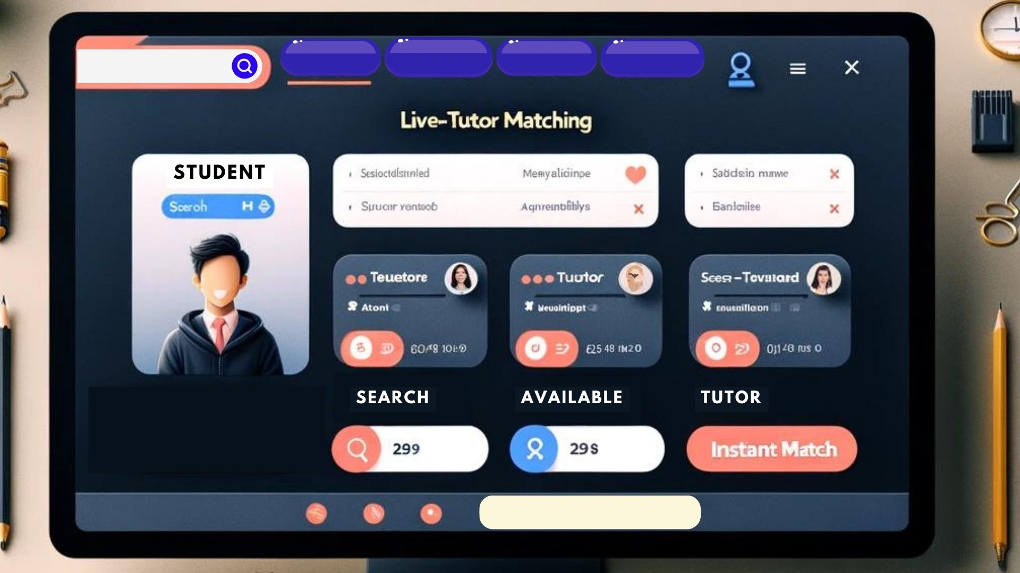
04 Solutions
Mockup Design

Slide 10
Project timeline
Conduct market research and analyze the target audience to identify opportunities
Defining scope, gathering requirements, approving project plan
System and database design, UI/UX prototyping.
Backend and frontend development, components integration.
Unit, integration, and user acceptance testing
Deployment to production or staging environment.
User training, documentation, support, and maintenance.

Slide 11
06 Potential Risks
Technical Risks
System Integration challenges
Security Vulnerabilities
Scalability Issues
Operational Risks
Resistance to change
Maintenance challenges
Economic Risks
Overestimation of demand
Underestimation of cost

Slide 12
06 Risk Mitigation
Technical Risks
Employing Agile methodologies to ensure flexibility and adaptability in project execution.
Operational Risks
Regular stakeholder engagement to align expectations and gather feedback.
Establishing a robust testing framework to identify and address issues early.
Economic Risks
Creating a contingency budget to manage unforeseen expenses.

Slide 13
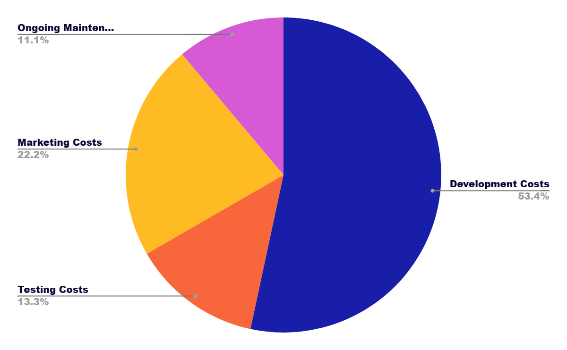
07 Project expenses
Development
Testing
Marketing
Maintenance

Slide 14
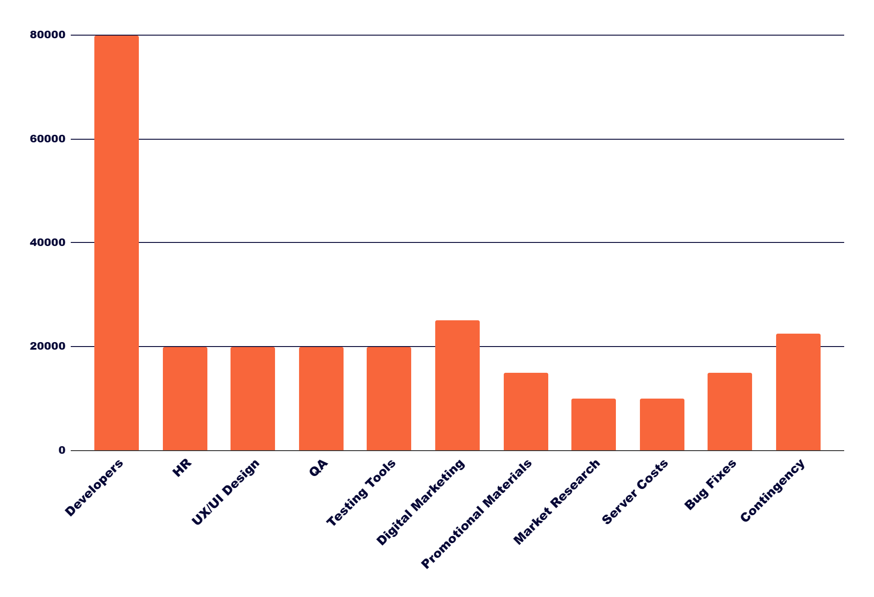
Resource Budget Allocation
This graph shows the budget allocated slit to each resource.
We also includes a 10% additional contingency budget to address unforseen financial needs.

Slide 15

$225,000
10%
Total Project Budget
Additional Contigency Budget

Slide 16
Conclusion
Market Validated
Feasibility Confirmed
Evidence of demand and projected success in the educational landscape.
Technical, operational, and economic viability established through in-depth analysis.
Strategic Roadmap
Comprehensive project plan ensuring timely execution and delivery.
Proactive Risk Management
Robust Financial Planning
Identification and mitigation of potential challenges to safeguard project success.
Detailed budgeting with a contingency plan to support project phases.

Slide 17
Call to Action and Future Steps
We look forward to discussing further details, addressing any questions, and collaborating closely with all stakeholders as we move towards the implementation phase.
We would also be looking for investors to help making this application a huge success.

